Slide 1

Viva Connections & SharePoint Framework Bi-weekly sync
aka.ms/m365pnp
Your host in this call: Patrick Rodgers
May 5, 2022
Microsoft 365 PnP Team

Slide 2





Agenda
Latest update on SharePoint Framework
Patterns and Practices Updates
PnPjs
CLI for Microsoft 365
Reusable PnP SPFx controls
New Community Samples
Picture time with Together Mode!
Demos
Adam Wójcik - Manage data in OneDrive application folder
Marcin Wojciechowski (Valo) - Auto Batching Graph Calls
Hugo Bernier (Microsoft) – SPFx Design Patterns
Have a great day! 👍
You are awesome! 🧡
Thank you for being part of the community 👏

Slide 3
Opportunities to Participate in PnP SPFx / JS SIG
SPFx Demo
@pnp Demo
Contribute on GitHub
Provide Feedback
Web Part
Application Customizer
Provisioning
Anything you create!
PnPjs
CLI for Microsoft 365
SPFx Reusable Controls
SPFx Community Yeoman
Report Issues
Submit Pull Requests
Help with issues/questions
How are the calls?
Documentation needs?
Where can we help?
Positive is OK too!
Great opportunity to get visibility for you or your company. Demo sample or explain how you extend or customize SharePoint Online with live demo in your projects. Reach out to team for volunteering.
Request a demo spot on the call
https://aka.ms/m365pnp/request/demo

Slide 4
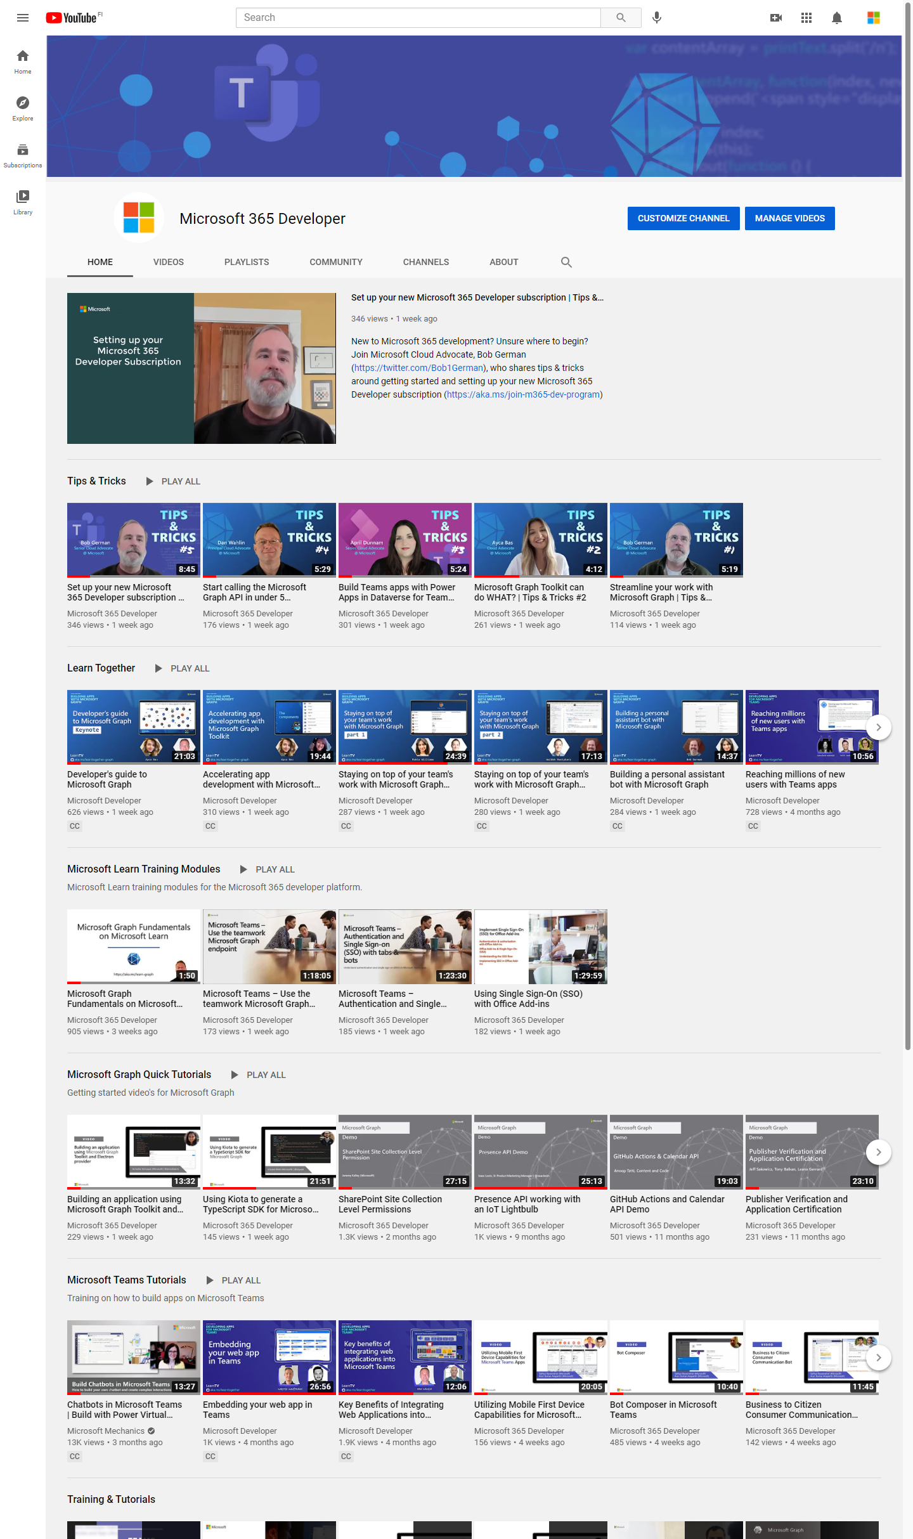
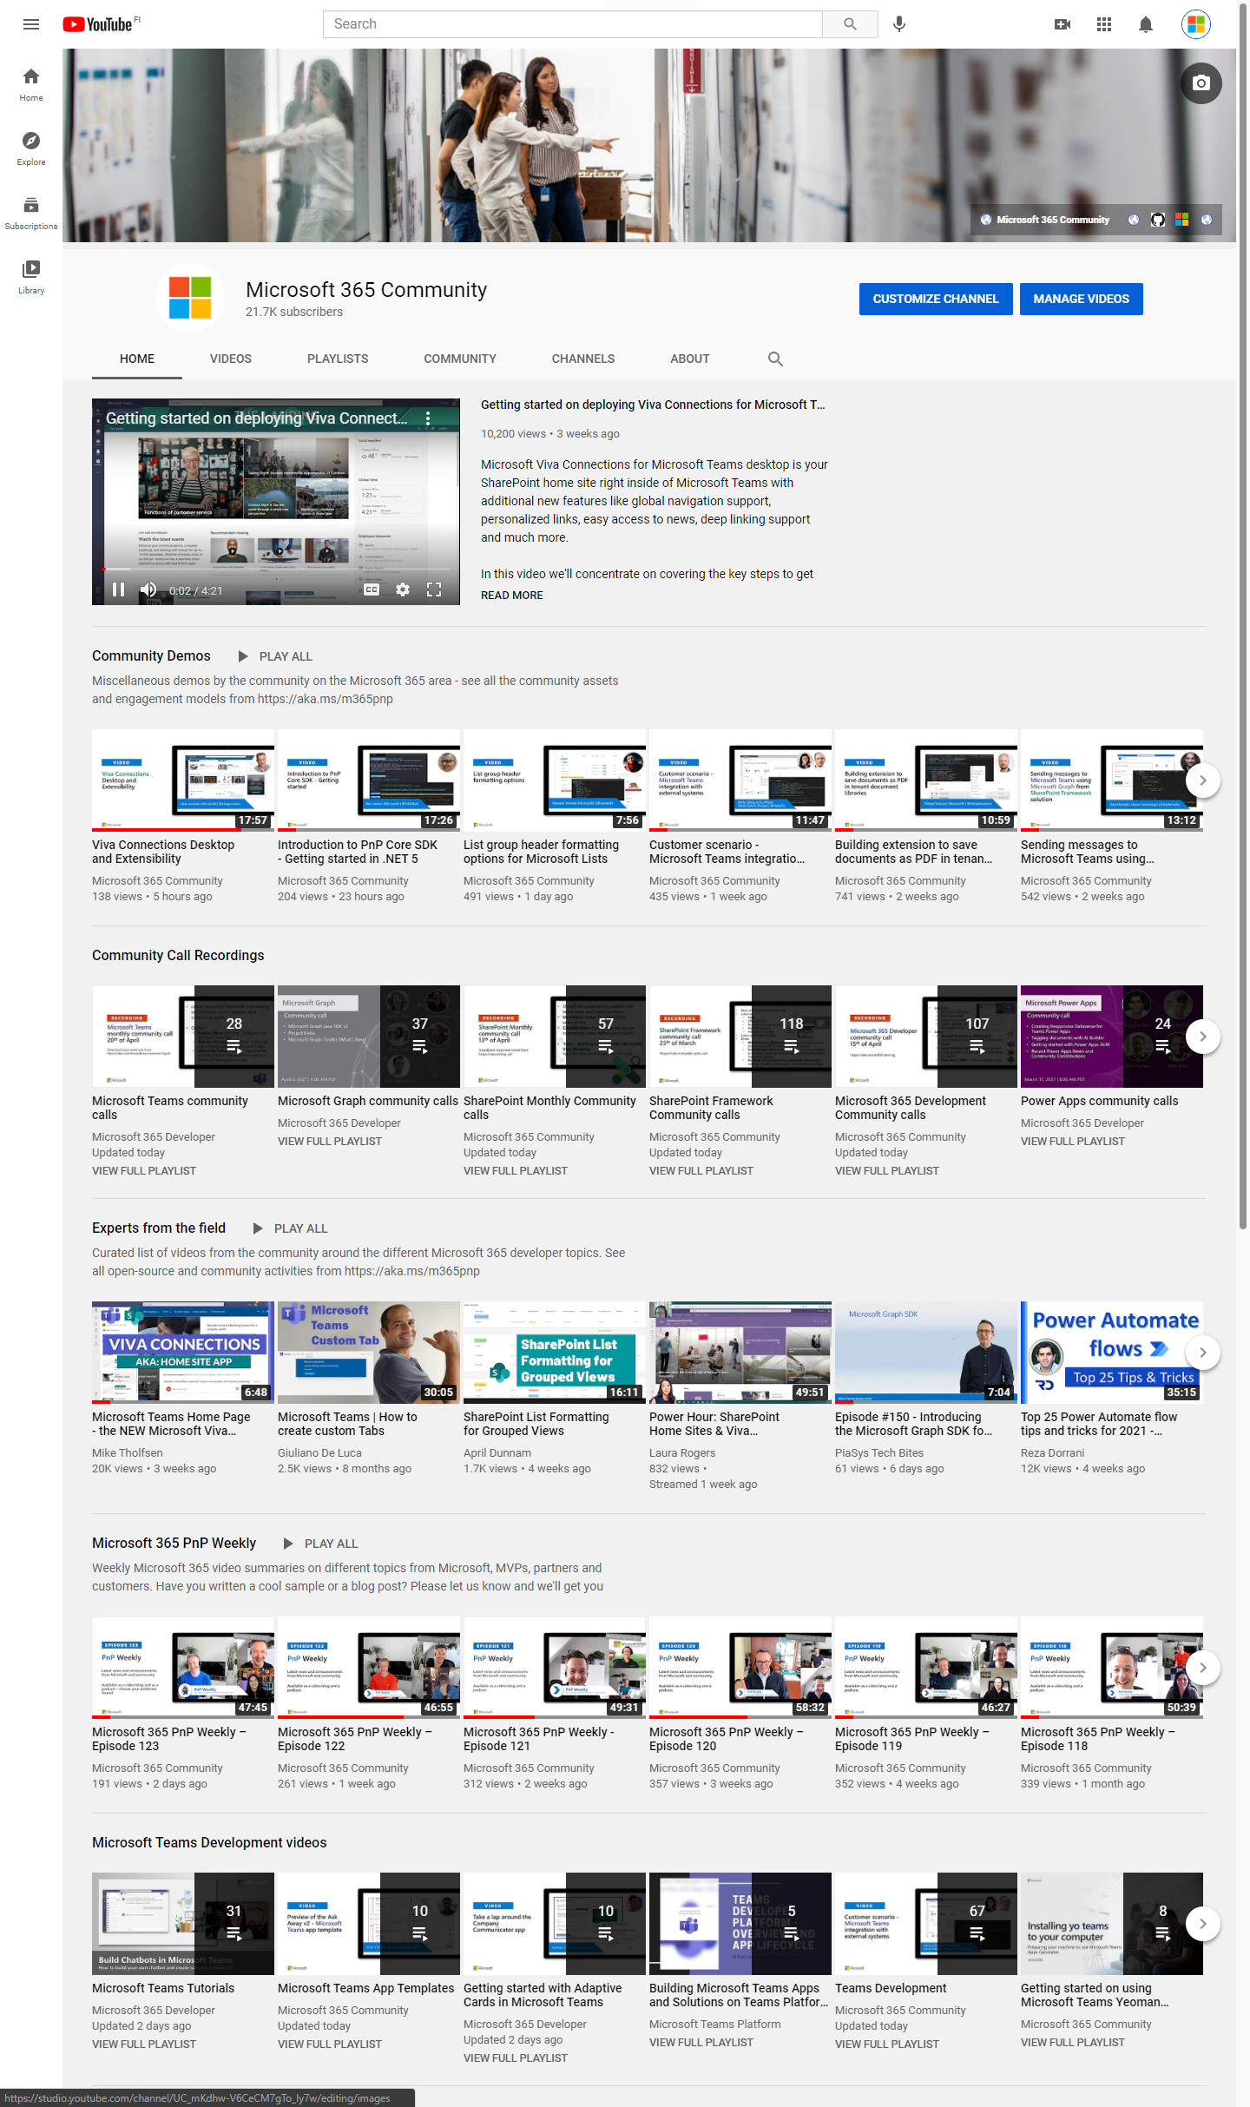
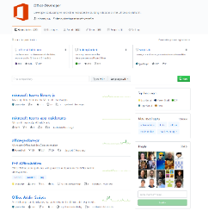
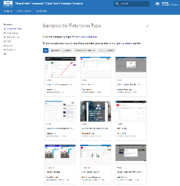
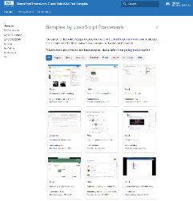
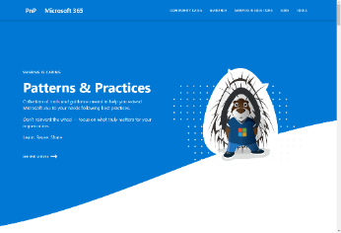
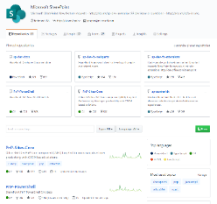
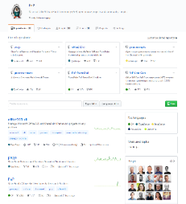
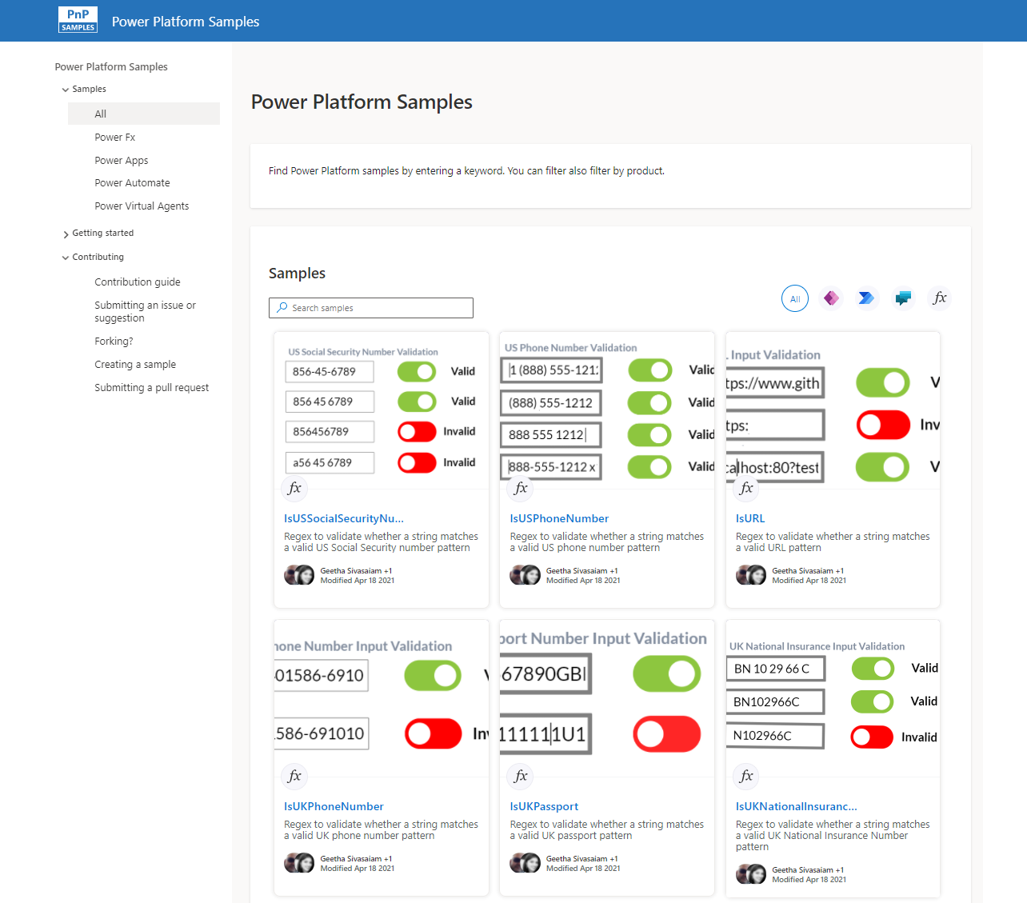
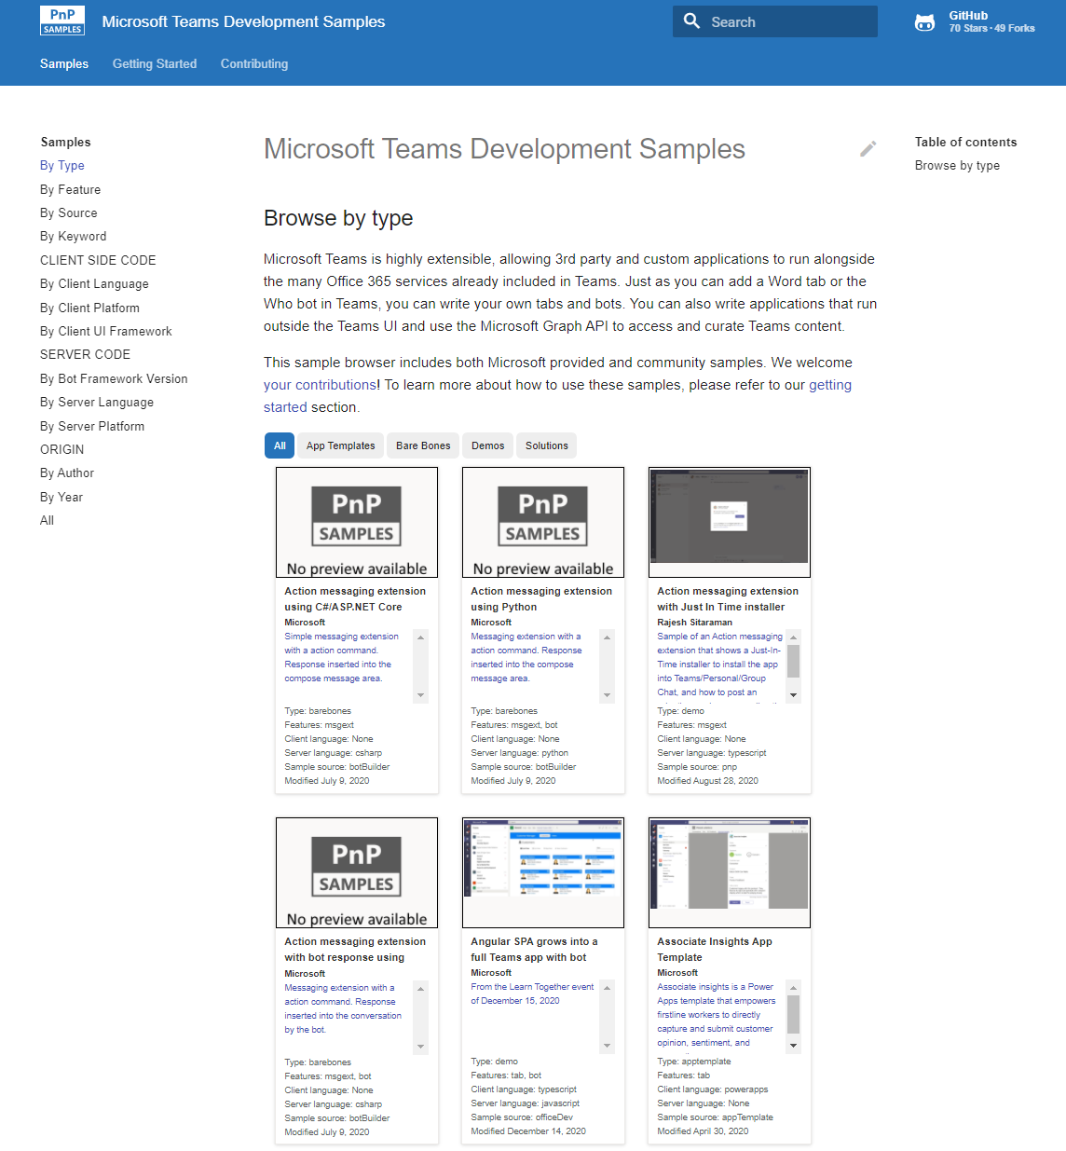
Microsoft 365 developer videos
Microsoft 365 community videos
Open-source
Sample galleries
Open-source initiatives and samples
aka.ms/m365devyoutube
aka.ms/m365/videos
github.com/pnp
github.com/officedev
github.com/microsoftgraph
github.com/sharepoint
aka.ms/m365/samples
aka.ms/teams-samples
aka.ms/spfx-webparts
aka.ms/spfx-aces
aka.ms/powerplatform-samples
aka.ms/spfx-extensions
aka.ms/list-formatting
aka.ms/m365pnp
@Microsoft365Dev | @m365pnp
One URL to rule them all…

Slide 5
Microsoft 365 developer community calls
Microsoft 365 platform https://aka.ms/m365-dev-call
Adaptive Cards https://aka.ms/adaptivecardscommunitycall
Microsoft identity platform https://aka.ms/IDDevCommunityCalendar
Office Add-ins https://aka.ms/officeaddinscommunitycall
Power Platform https://aka.ms/PowerPlatformMonthlyCall
Microsoft 365 Dev Community (bi-weekly) https://aka.ms/m365-dev-sig
Viva Connections and SPFx (bi-weekly) https://aka.ms/spdev-spfx-call
https://aka.ms/m365pnp
Notes:
m365-dev-sig

Slide 6

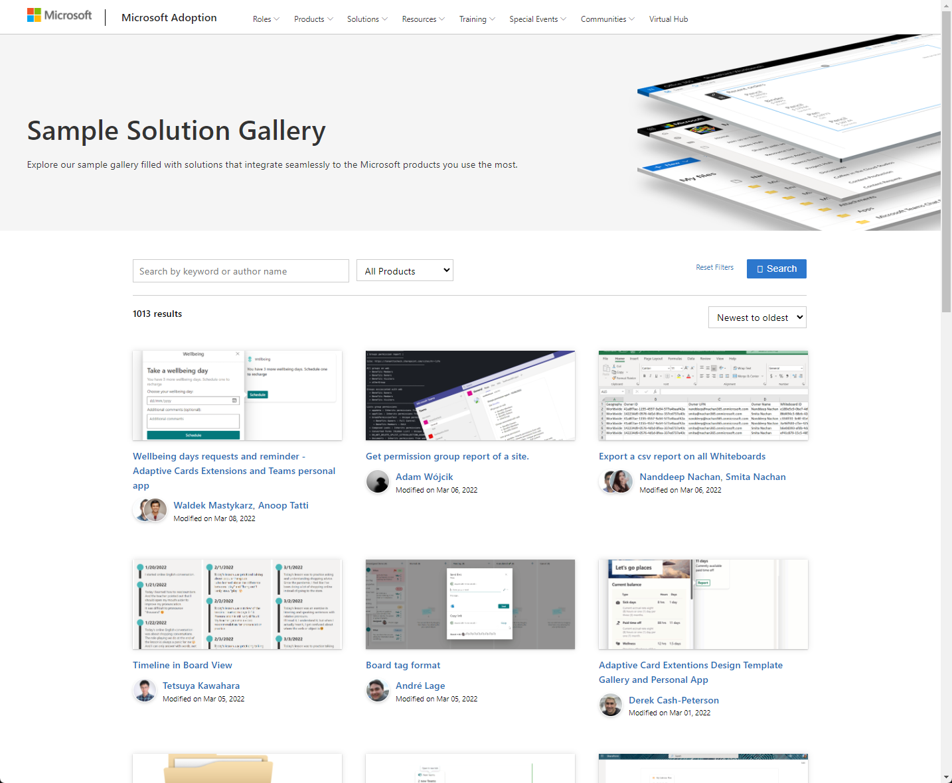
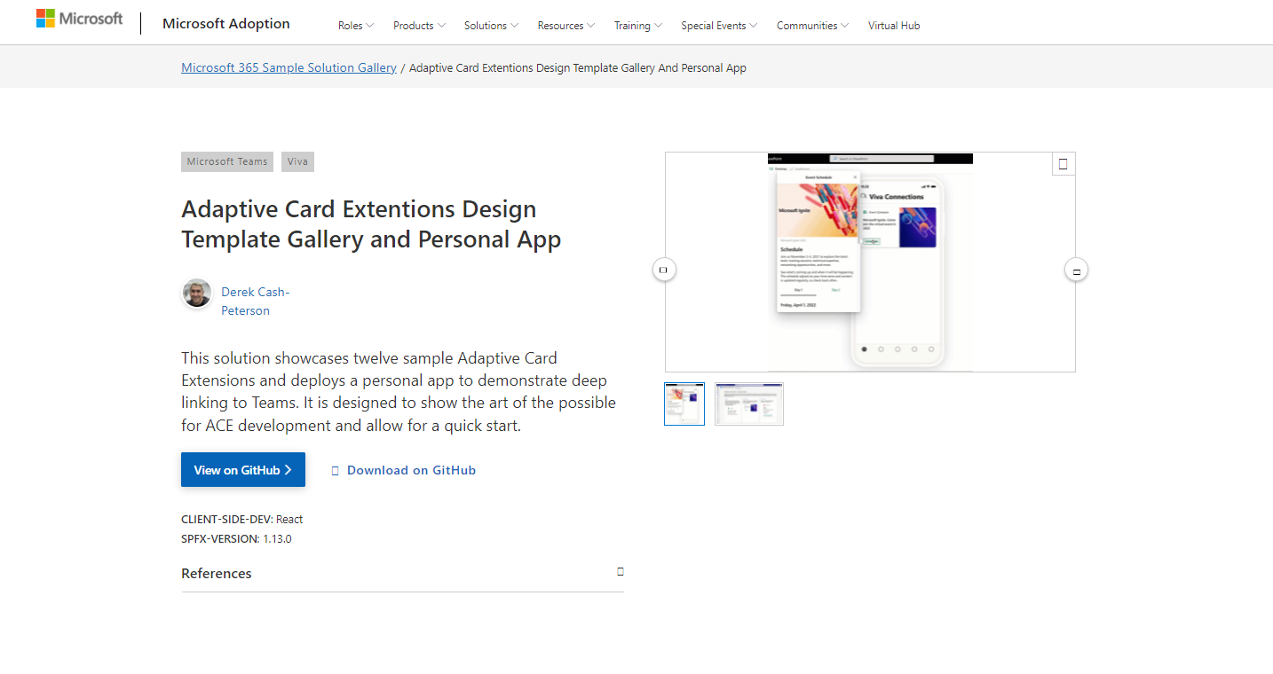
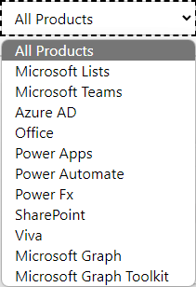

SAMPLES
New Microsoft 365 sample gallery with more than 500 samples from Microsoft and community
1060
aka.ms/m365/samples

Slide 7







Latest news from Microsoft engineering on Microsoft 365 topics
Monthly community contributors
Community together mode group photo
Divyanka Pillai and Michelle Lee - Additional Contextual Actions in your Extended App
David Rousset - Getting started on using Azure Communication Services in your web site
AGENDA
Microsoft 365 platform call 10th of May @ 8 AM PT
Weekly call with Microsoft presenters covering the latest Microsoft 365 platform updates
Download recurrent invite from https://aka.ms/m365-dev-call
Notes:
Dan’s slide

Slide 8
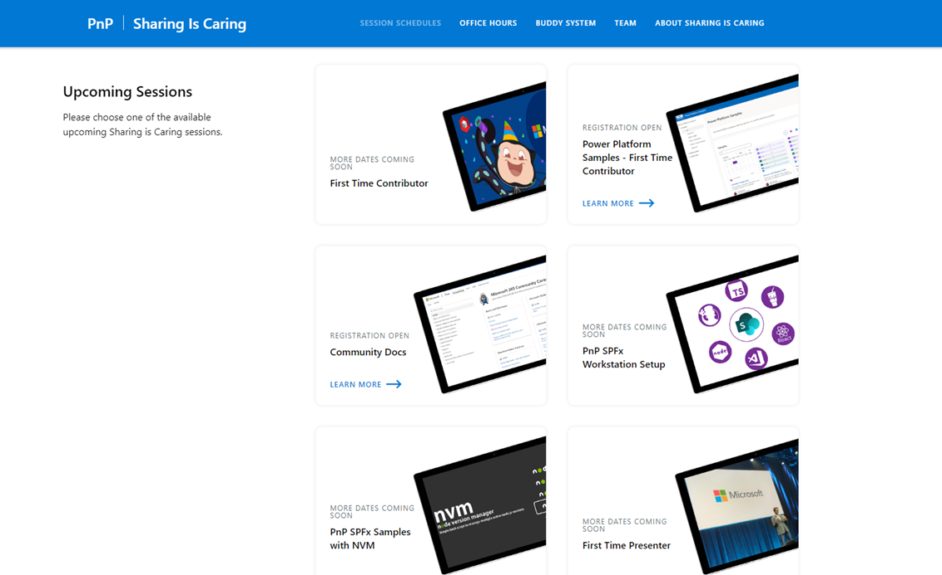
GUIDANCE
Learn how to get started in the open-source PnP community!
Upcoming Sessions:
First-time contributor
Power Platform Samples – First Time Contributor
Community docs
Using PnP SPFx samples w/ NVM
SPFx developer workstation setup
More than code with VS Code
First-time presenter
M365 Maturity Model Practitioners
Power Platform Samples – First Time Contributor
NEXT WEEK!!
https://aka.ms/sharing-is-caring
Notes:
25 Total attendees, 16 attendees who attended both First-Time Contributors and Community Docs sessions.

Slide 9





COMMUNITY
PnP Recognition Program
Showcase your contributions
Powered by Credly
More achievement levels coming soon
https://aka.ms/m365pnp-recognition
Notes:
25 Total attendees, 16 attendees who attended both First-Time Contributors and Community Docs sessions.

Slide 10
SharePoint Framework Latest from Microsoft engineering for Microsoft Viva, Microsoft Teams and SharePoint extensibility

Slide 11
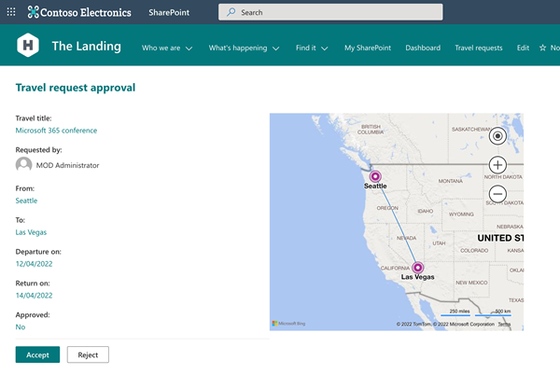
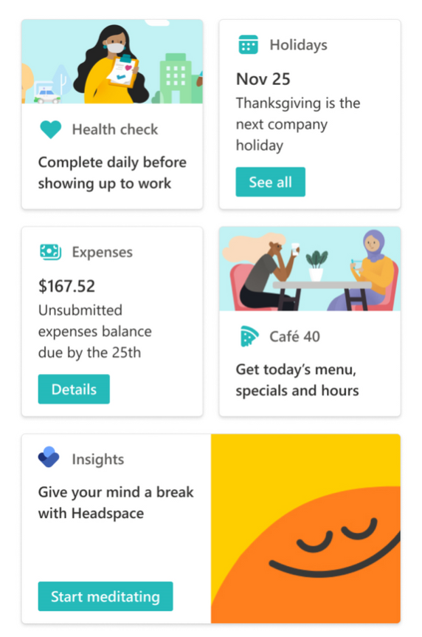
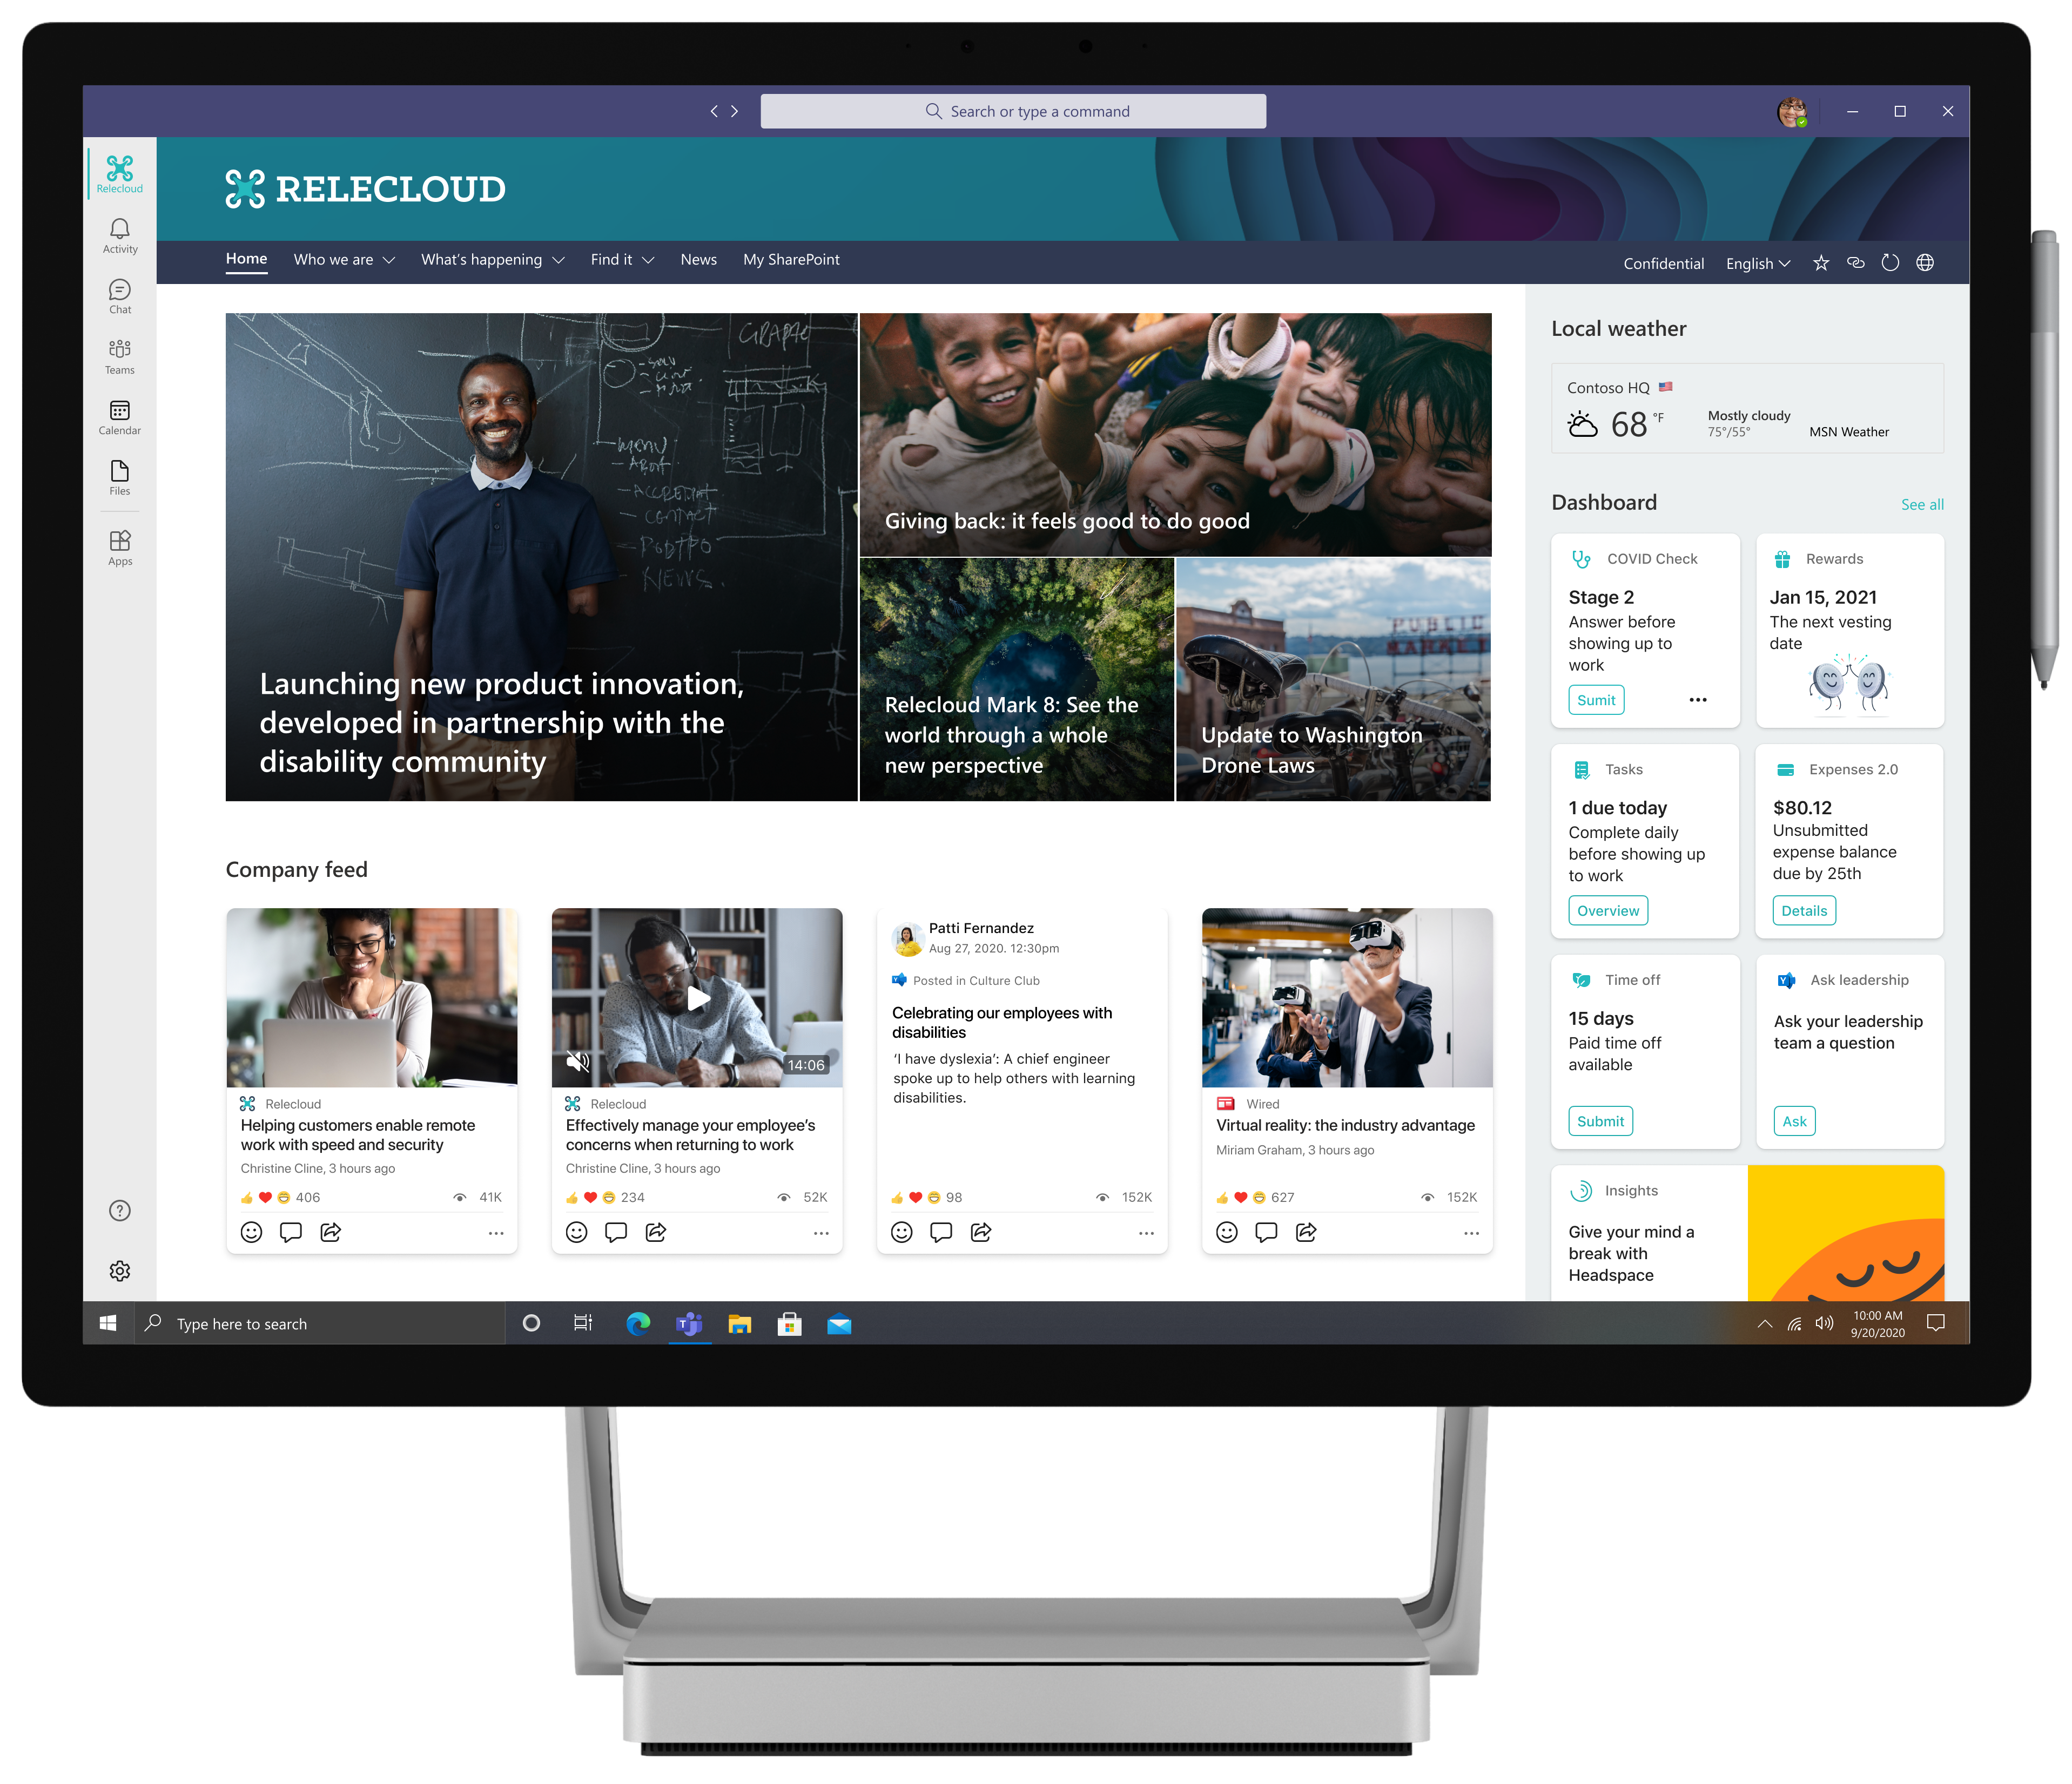
List form extensibility preview included!
UPDATE
SharePoint Framework 1.15 public developer preview available!
Preview on the upcoming SharePoint Framework version now available with updated features for Microsoft Teams, Microsoft Viva and SharePoint Online
npm install -g @microsoft/generator-sharepoint@next
Notes:
Dan’s slide

Slide 12
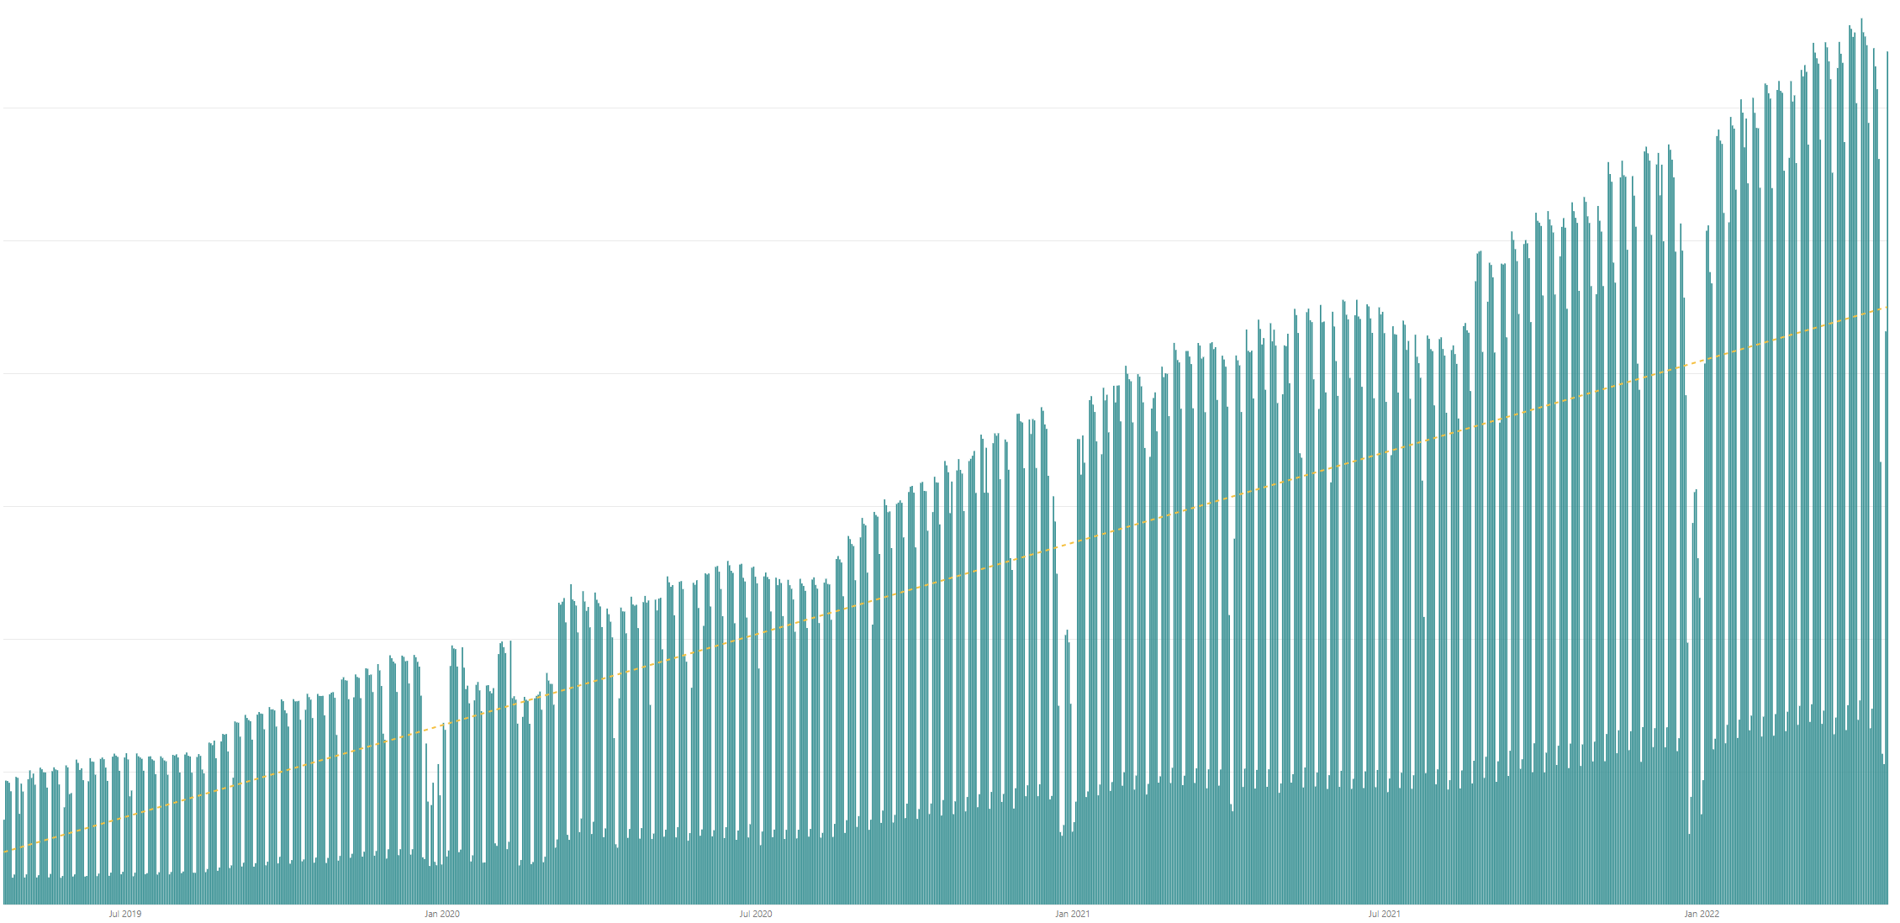

Daily active users for custom SharePoint Framework components in M365 There are currently tens of millions of monthly active users for customer and partner created SharePoint Framework components in Microsoft 365
Jul 2019
Jan 2020
Jul 2020
Jan 2021
Jul 2021
Jan 2022

Slide 13




The Road Ahead – 1.15 Release – ETA June 2022
Q2 CY 2022
Latest 1.15 preview release
New Action types for media and geolocation – Tutorial just published
Support for Microsoft Graph SDK V3
Bug fixes and adjustments based on GitHub issues
New customizers for add and edit list / library forms
Available later as we progress in 1.15 development
Adaptive Card Extensions card view caching
Adaptive Card Extensions Error Handler Method
Adaptive Card Extensions card view caching – move to GA
Leverage Teams OBO flow for SPFx components in Teams Web
Support for TypeScript V4
Support for Teams SDK v11 (or newer – most likely 1.12.1)
Enable Service Principal Registration in app acquisition flow
Isolated Adaptive Card Extensions (Beta)
Post 1.15
Bots Powered Adaptive Card Extensions (Beta)**
Support for Node V16 – Delayed unfortunately due to dependency on Office Ui Fabric version used in SharePoint Online

Slide 14

PnPjs Client-Side Libraries

Slide 15
























PnPjs Client-Side Libraries
Version 3.3 released May 13th
General documentation updates
Add getLockedByUser method for files
Addresses many reported issues and enhancements
Don’t forget about the nightly builds
npm install @pnp/sp@v3nightly --save
Docs: https://pnp.github.io/pnpjs/ @m365pnpjs on twitter

Slide 16
CLI for Microsoft 365

Slide 17
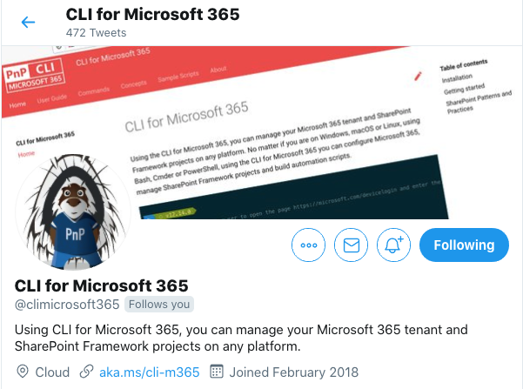
CLI for Microsoft 365
New version v5.2 with:
Extended SPFx project upgrade guidance to include SPFx fast serve
Upgrading SPFx projects to SPFx v1.15.0-beta.6
Simplified logging in to Microsoft 365
Support for adding private Teams channels
Managing private Teams channels
Managing Power Platform solutions
Extended support for Planner
Retrieving AAD signins information
Install v5.2:
npm install -g @pnp/cli-microsoft365@latest
docker run --rm –it m365pnp/cli-microsoft365:latest
Release notes:
https://pnp.github.io/cli-microsoft365/about/release-notes/#v520
Available natively in Azure Cloud Shell
@climicrosoft365 #CLIMicrosoft365 on Twitter
📖 aka.ms/cli-m365
🗣 github.com/pnp/cli-microsoft365/discussions

Slide 18
SPFx Reusable Components

Slide 19
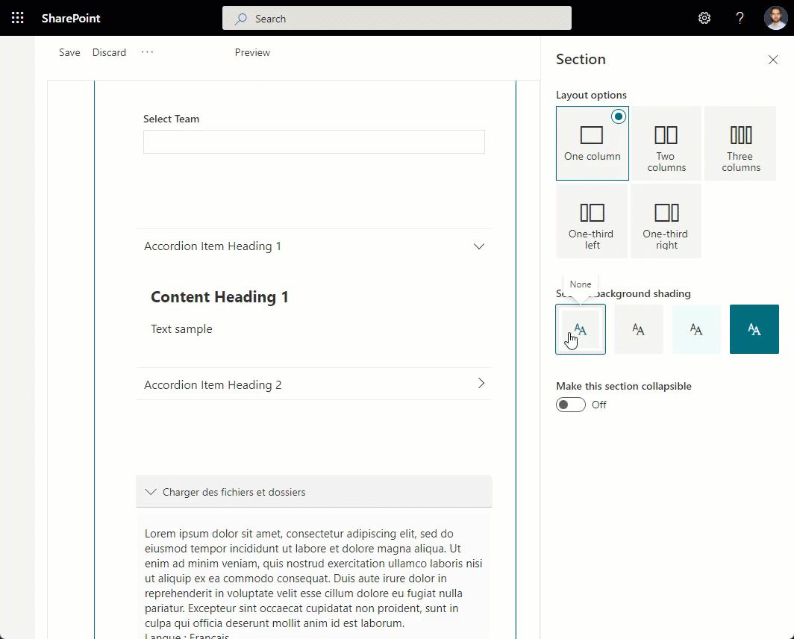
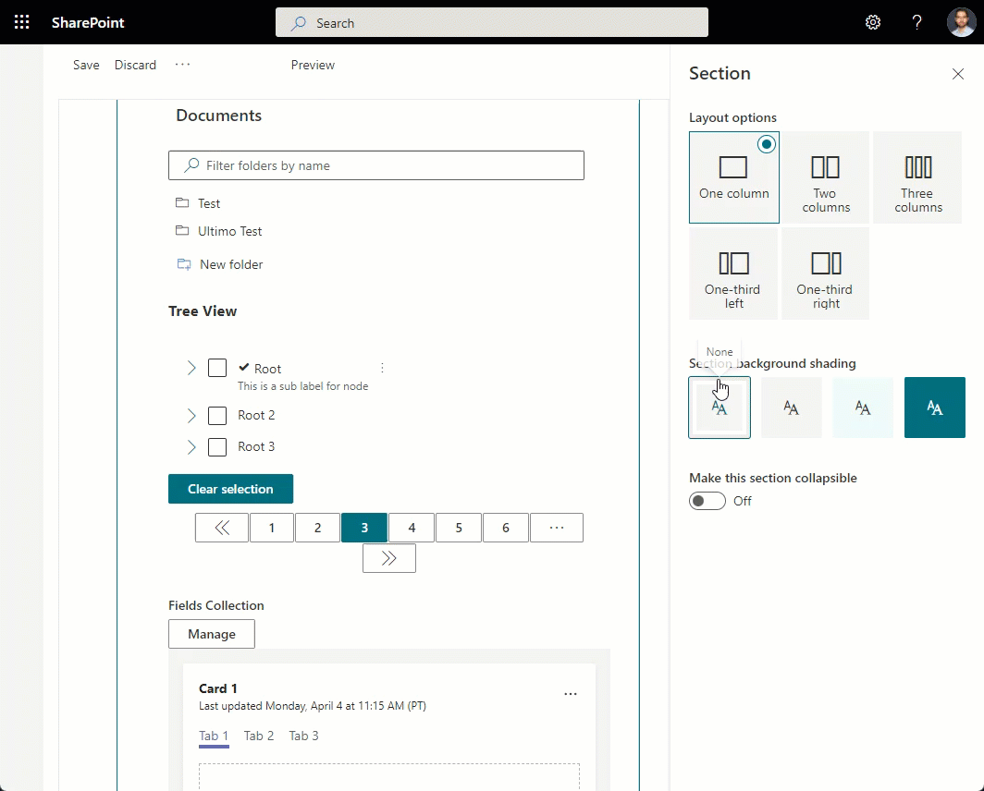
Reusable SPFx Controls
React Controls – 3.8.0
PeoplePicker enhancements: ability to provide multiple group id-s, search in nested groups
AdaptiveCardHost enhancements: add SPFx context, re-think CSS classes generation
Support for section backgrounds in AccessibleAccordion and TreeView
Various fixes
Release notes: https://pnp.github.io/sp-dev-fx-controls-react/about/release-notes/
React Property Controls – 3.7.0
PropertyFieldListPicker: ability to provide content type id
PropertyFieldColorPicker: provide preview of the selected color
Release notes: https://pnp.github.io/sp-dev-fx-property-controls/about/release-notes/
Special thanks to our contributors: Andreas Omayrat, brianpmccullough, Christophe Humbert, Fabio Franzini, Gautam Sheth, Joel Lopes, Milan Holemans, Patrik Hellgren, Ravichandran Krishnasamy, Rico van de Ven, Russell gove.
More information:
https://sharepoint.github.io/sp-dev-fx-property-controls https://sharepoint.github.io/sp-dev-fx-controls-react
Twitter: @M365PnPControls

Slide 20
PnP SPFx Community Yeoman Generator

Slide 21
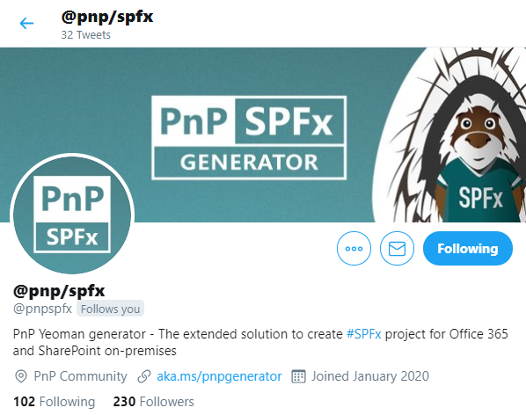
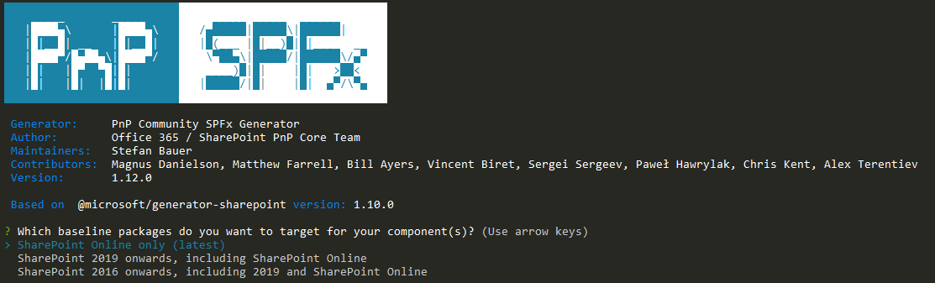







PnP SPFx Generator
@pnp/generator-spfx - 1.16.0
In progress and on the way to 1.17.0
Upgrade to SPFx 1.12.1 in progress
Drop of IE11 support (optional)
Angular 12 support
Update of outdated libraries
UPDATES REQUESTED
Install the latest version via npm: npm install -g @pnp/generator-spfx
Documentation: https://aka.ms/pnpgenerator
Chat on Gitter: https://gitter.im/generator-spfx/generator

Slide 22
PnP Modern Search

Slide 23
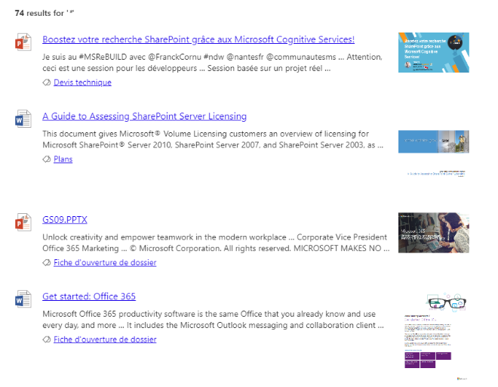

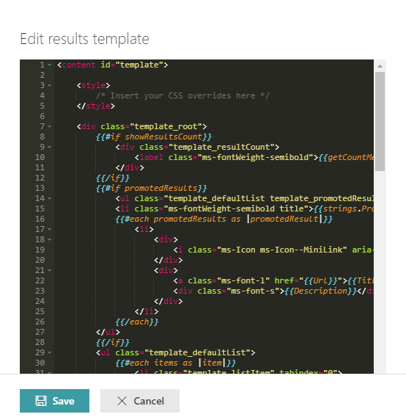
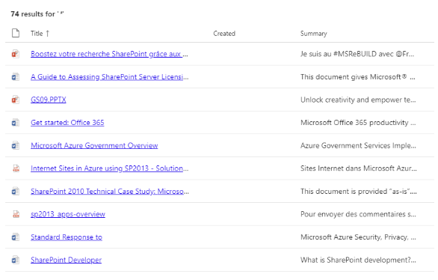


PnP Modern Search
http://aka.ms/pnp-search
Building modern Search experiences with flexible web parts
v4.6.1 – April 2022 release
https://github.com/microsoft-search/pnp-modern-search/releases/latest
Thank you @gszdev, @kachihro, @edarroudi, @eduardpaul, @dominiqueborer, @kflogdev for your support 😍
See release notes for fixes and new features
v3.23.0 – December 2021 release
https://github.com/microsoft-search/pnp-modern-search/releases
See release notes for fixes and new features
Notes:
https://github.com/microsoft-search/pnp-modern-search

Slide 24

PnP SPFx Samples

Slide 25
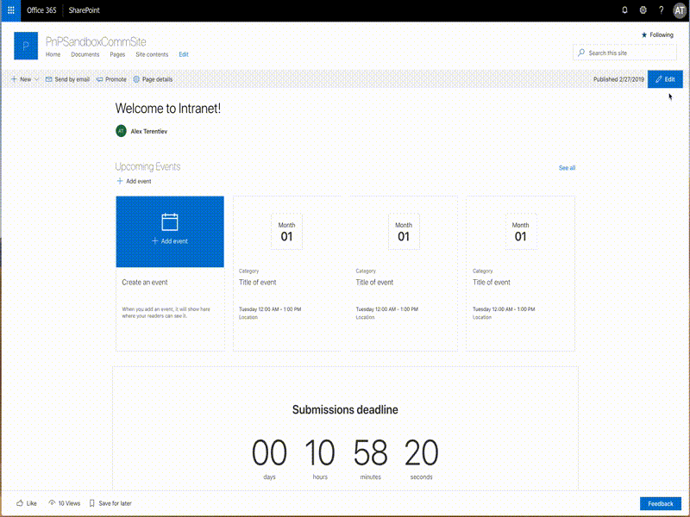
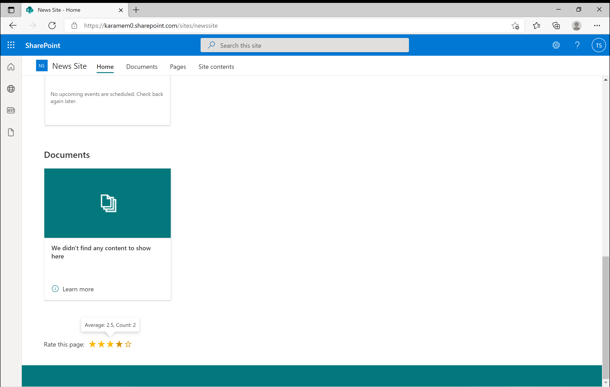
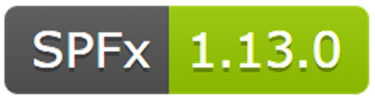
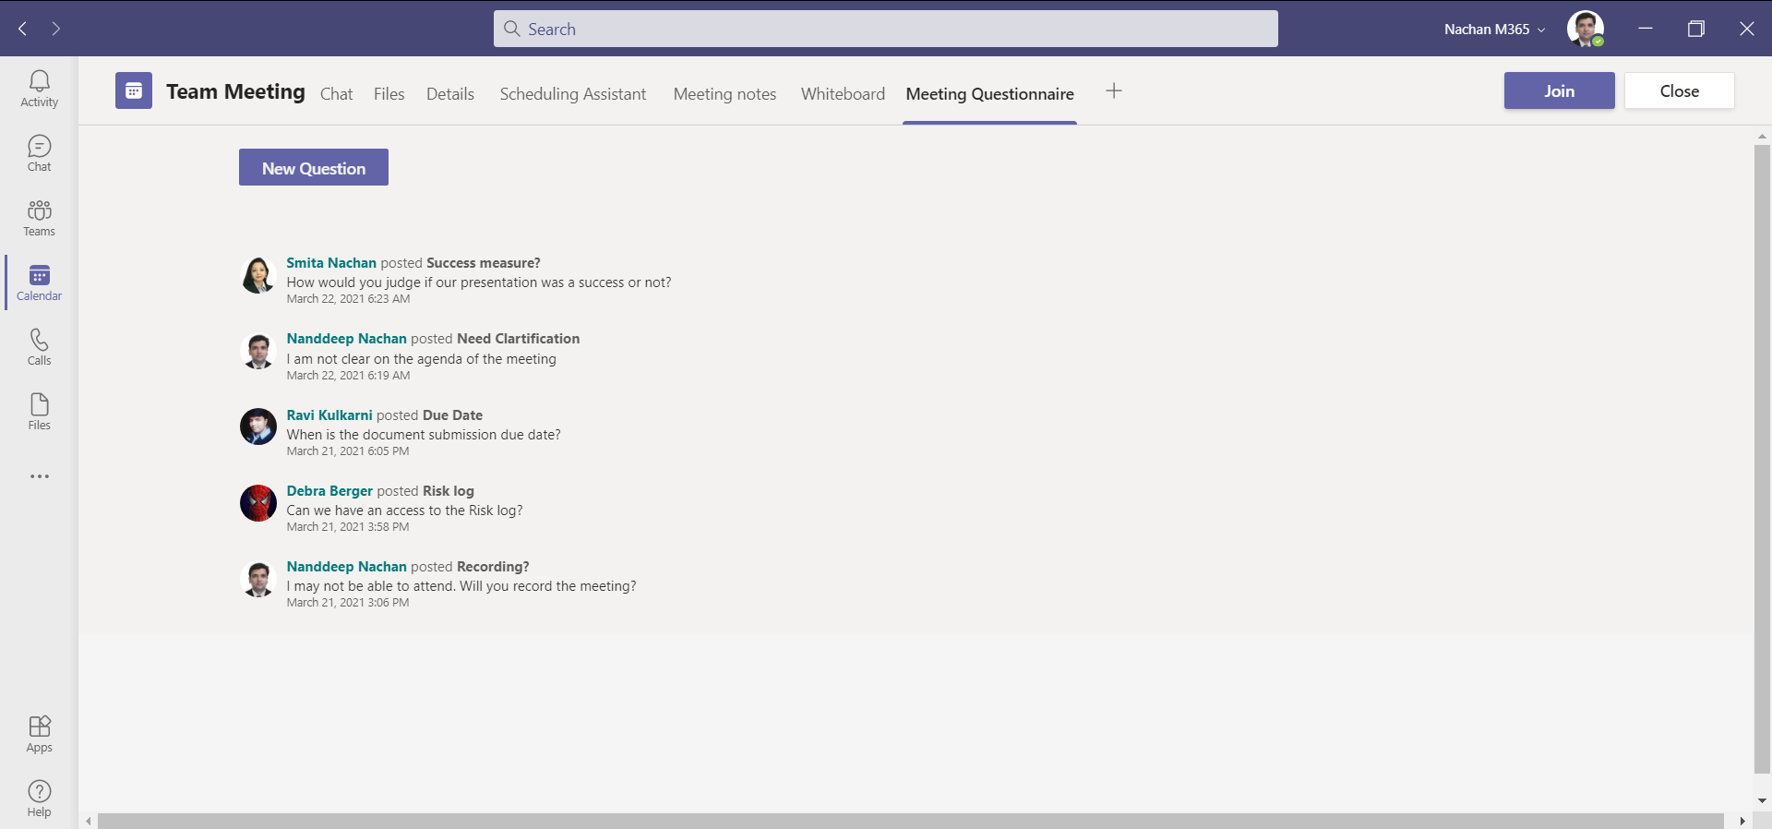
PnP SPFx Samples
PnP SPFx Samples
PnP SPFx Samples
https://aka.ms/spfx-extensions
Nothing new
https://aka.ms/spfx-webparts
Page Navigation Alex Terentiev | @alexaterentiev
Teams Meeting App Questionnaire Nanddeep Nachan | @NanddeepNachan
Star Ratings Takashi Shinohara | @karamem0
Follow Documents André Lage | @aaclage
💖 Denis Molodtsov | @zerg00s, Abderahman Moujahid | Abderahman88, Milan Holemans | milanholemans
Notes:
If you’re starting a new development task with SPFx, you could build everything from scratch on your own,
OR you could leverage the awesome samples that were built by the community.
We have two GitHub repositories: SPFx Web Parts, and SPFx Extensions where you can find samples contributed by the community, ranging from simple concepts (like how to use a control, for example) to full solutions and utilities.
We welcome contributions from everyone.
These are the updates for the last two weeks
SPFx extensions https://aka.ms/spfx-extensions
News Ticker Sudharsan Kesavanarayanan | @sudharsank Upgraded to SPFx 1.14 and added properties for background color and text color https://github.com/pnp/sp-dev-fx-extensions/blob/main/samples/react-application-news-ticker
SPFx web parts https://aka.ms/spfx-webparts
Page Navigation Alex Terentiev | @alexaterentiev
Upgraded to SPFx 1.14
https://github.com/pnp/sp-dev-fx-webparts/tree/main/samples/react-page-sections-navigation/README.md
Teams Meeting App Questionnaire Nanddeep Nachan | @NanddeepNachan
Upgraded to SPFx 1.14
https://github.com/pnp/sp-dev-fx-webparts/tree/main/samples/react-teams-meeting-app-questionnaire
Star Ratings Takashi Shinohara | @karamem0
Updated to show averages with stars instead of user ratings
https://github.com/pnp/sp-dev-fx-webparts/tree/main/samples/react-star-ratings

Slide 26
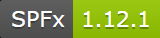
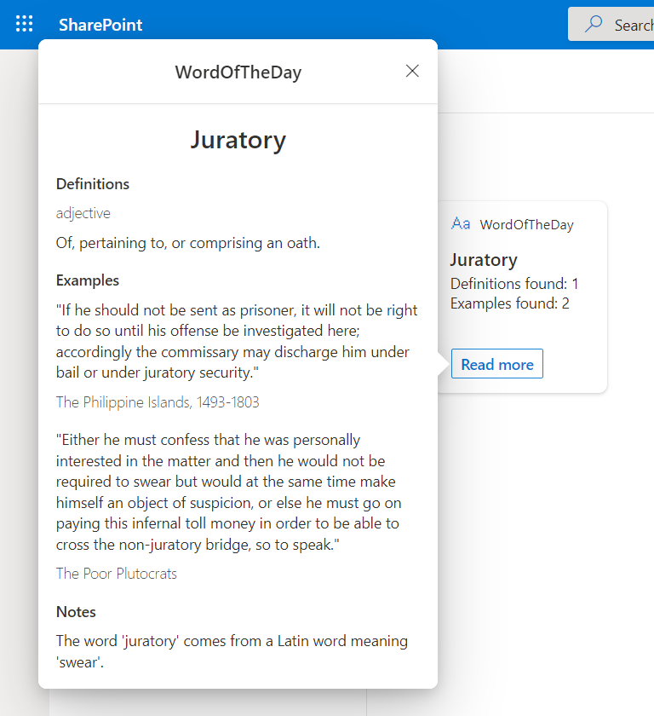
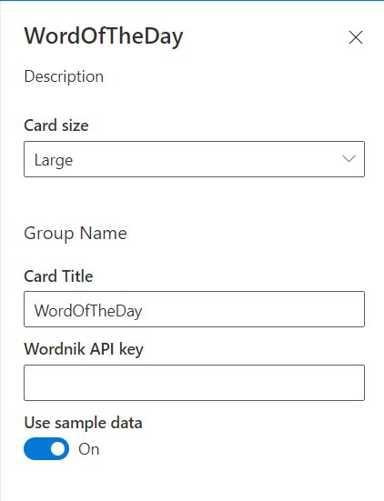
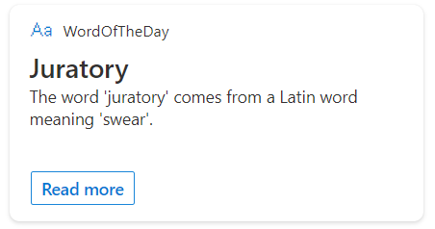
PnP SPFx ACEs
PnP SPFx Samples
PnP SPFx Samples
https://aka.ms/spfx-aces
Word of the Day Guido Zambarda | GuidoZam
*** Open for More Contributions ***
Follow Documents André Lage | @aaclage
Notes:
This adaptive card extension sample demonstrate ability to monitor security risks using identity protection graph api from Viva Connection Dashboard
SPFx extensions https://aka.ms/spfx-extensions
Copy/Move Items within Lists Sudharsan Kesavanarayanan | @sudharsank This application customizer will display a command button named Copy/Move Item(s) in all the custom lists. Using this option, the items can be copied or moved from one list to another within the site.
https://github.com/pnp/sp-dev-fx-extensions/tree/main/samples/react-command-copy-move-items
SPFx web parts https://aka.ms/spfx-webparts
Applications Secrets Expiration Aimery Thomas | @a1mery This sample web part shows the list of your applications registered in Azure AD along with their associated client secret/certificate expiration date. https://github.com/pnp/sp-dev-fx-webparts/tree/main/samples/react-graph-app-secret-expiration
Teams Membership Updater
Nick Brown | @techienickb
Fixed the /members in the private channel membership URL
Advanced Page Properties Abderahman Moujahid | Abderahman88
Added support for web parts on sites in a different language
NEW: News Alison Collins | ReactIntern Web part pulls all SharePoint News Posts that the logged in user has access to view.
Pagination ( Back/Next ) and Page Display ( n out of n )
Select Multiple Sites ( Defaults to site webpart is deployed to )
Two styling options, Stack or Single
News Title as link ( Click to go to post )
News Thumbnail Image
Preview of Description
Author ( Can toggle visibility in Property Pane )
Created Date
Likes with Office UI Fabric Icons
Comments with Office UI Fabric Icons ( Also retrieves nested comments )
https://github.com/pnp/sp-dev-fx-webparts/tree/main/samples/react-news

Slide 27



Optional picture time!
Video on and we’ll grab a Together Mode pic with those who are willing to do this.
We are together on this as a community!
Let’s all be like Seb?
By enabling your camera for the picture, you grant us permission to share your picture in social media.

Slide 28

DEMO
Manage data in OneDrive application folder
– Adam Wójcik
Auto Batching Graph Calls
– Marcin Wojciechowski
SPFx Design Patterns
– Hugo Bernier (Microsoft)

Slide 29
Thank you
Recording will be available in 24 hours on
Microsoft 365 Community (PnP) YouTube channel
https://aka.ms/M365/videos
(subscribe today)
Follow us on Twitter
@Microsoft365Dev | @M365PnP
Next Viva Connections & SPFx call: May 19th at 07:00am PT
Next M365 General Dev call: May 12th at 07:00am PT
All available community calls from https://aka.ms/m365/calls

Slide 30


aka.ms/m365pnp

